Slide 1




Optimising DC Bias in DCO-OFDM Lifi Systems Using Machine Learning
By
Shreepragatheesh Govindaraju 20241202 Supervisor: Dr Sarmad Soomro

Slide 2
Today’s Agenda
Introduction
Thesis Contribution
Literature Review
Problem Statement
Research Objectives
Research Significant
My Contribution/Novelty of This Work
Proposed Methodology
Results & Discussion
Conclusion
Limitation/Future Work

Slide 3
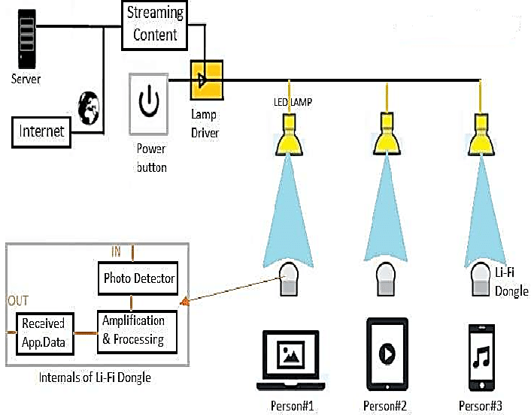

Introduction
What is Light Fidelity?

Slide 4
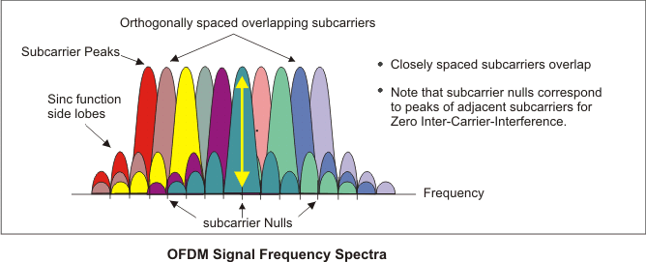
Introduction
What is OFDM (Orthogonal Frequency Division Multiplexing)

Slide 5
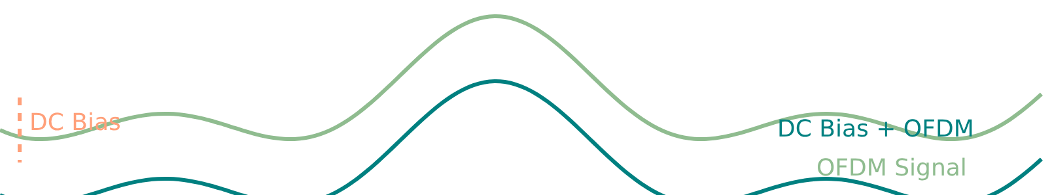
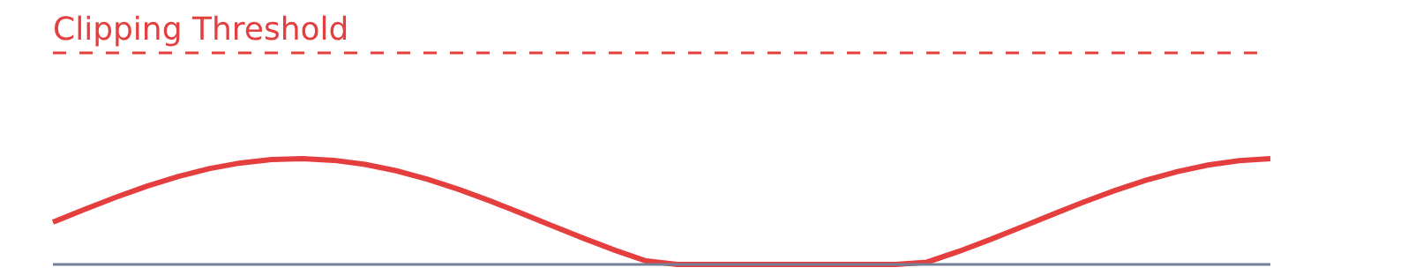
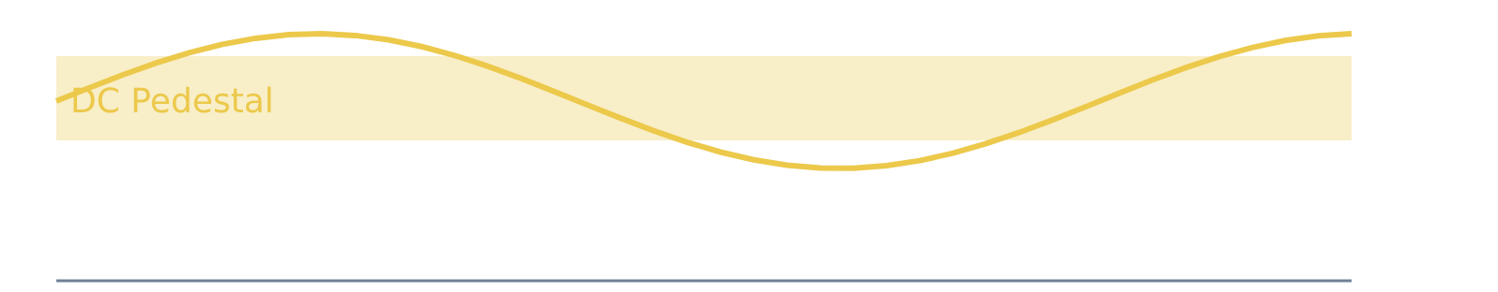
Introduction
What is DCO – OFDM?
DC biased Optical Orthogonal Frequency Division Multiplexing
Too Low DC Bias
Too High DC Bias

Slide 6
Thesis Contribution
Reformulates bias selection
End-to-end pipeline: simulation → ethical bias sweeps (for labels) → featureable dataset → model comparison (linear, SVR, trees, MLP) → system-level verification (BER/EVM).
Deployment frame : will have developed simulation and Ml model predictions
Notes:
[2]. https://idealcrm.app/construction-sales/top-7-sales-forecasting-benefits/

Slide 7
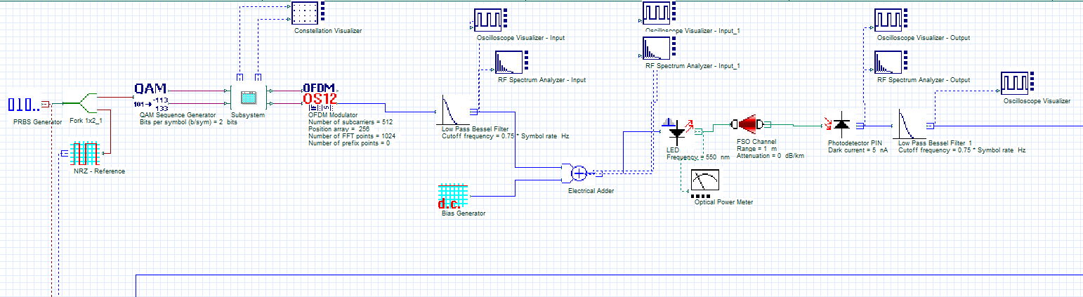

Optisystem Pipeline
Remote

Slide 8
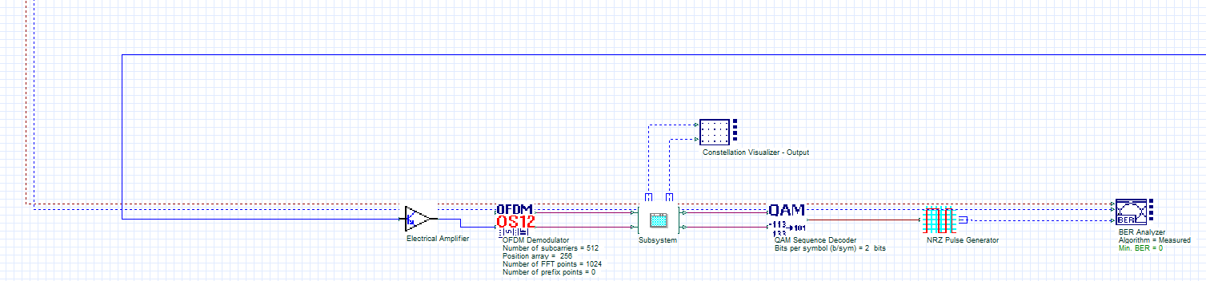

Optisystem Pipeline
Television

Slide 9
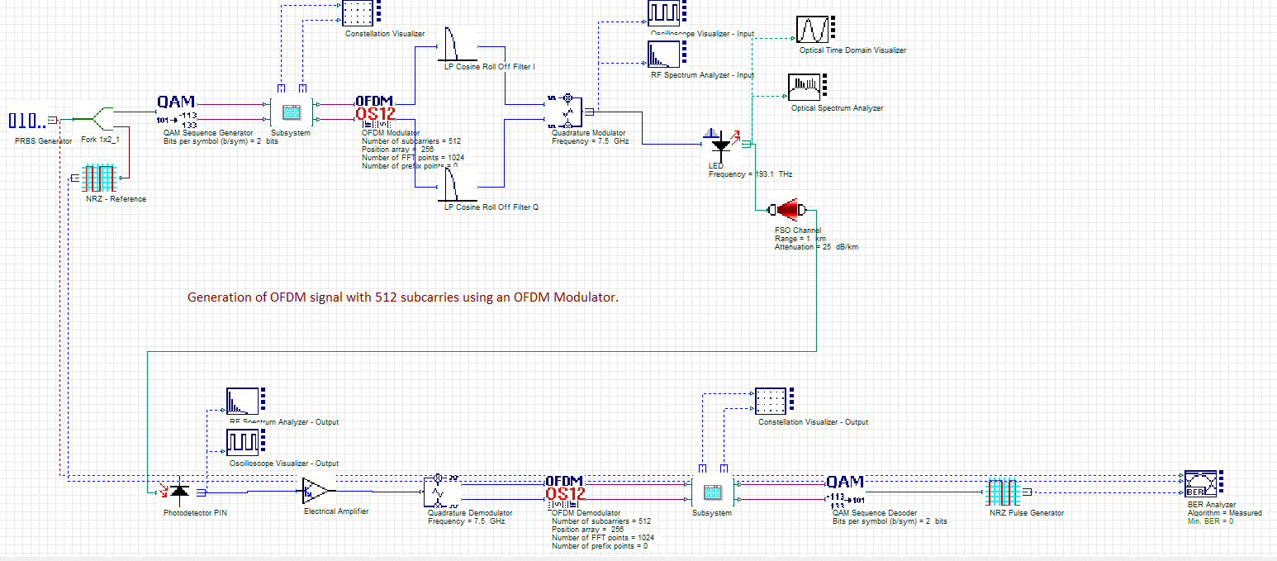
Optisystem Pipeline

Slide 10
Literature Review
Five threads: VLC/LiFi basics; optical OFDM; bias in DCO-OFDM; metrics (BER/EVM/PAPR); ML in optical links.
Gaps/critique:
Receiver-side ML “fixes” distortion but doesn’t stop transmitter waste or require smart clients—misplaced burden.
Closed-form bias formulas assume ideal physics & stationarity—brittle in real rooms.
Brute-force sweeps degrade service and don’t scale.
Need a transmitter-side, safe, auditable controller.

Slide 11
Problem statement
Given runtime features (SNR, Clip V, EVM, PAPR, Prx), can we predict a safe, near-optimal DC bias that minimises BER/EVM and energy waste without live sweeps?

Slide 12




Research Objectives
simulation & labeling; feature design
model dev (LR//RF/GB/MLP)
evaluation (MAE/RMSE/R² + BER/EVM re-run)
deployment with rules (clamps, override, uncertainty)

Slide 13






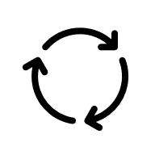

Proposed Methodology
2. Sweep
1. System Simulation
5. Evaluation
3. Dataset Construction
4. Model Training

Slide 14
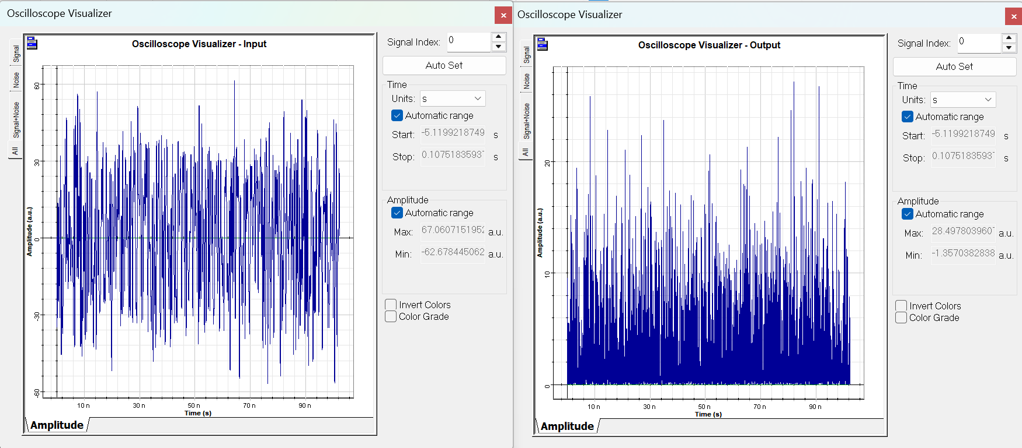
Results & Discussions
Simulation Output :

Slide 15
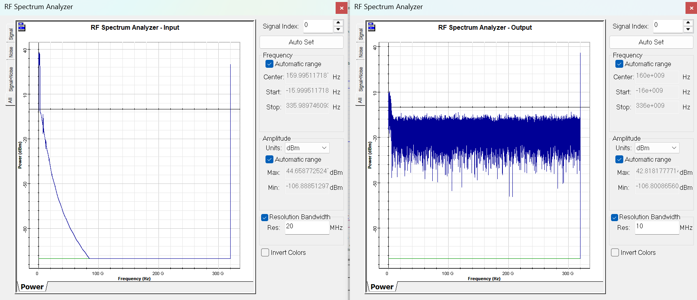
Results & Discussions
Simulation Output :

Slide 16
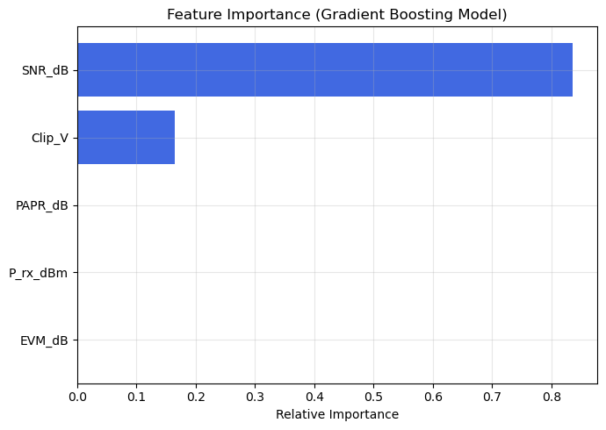
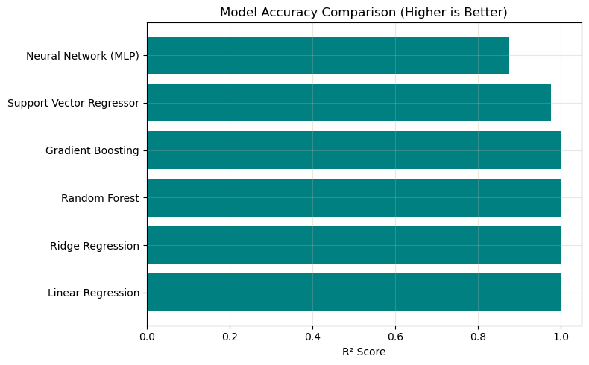
Results & Discussions
Machine Learning Output :

Slide 17
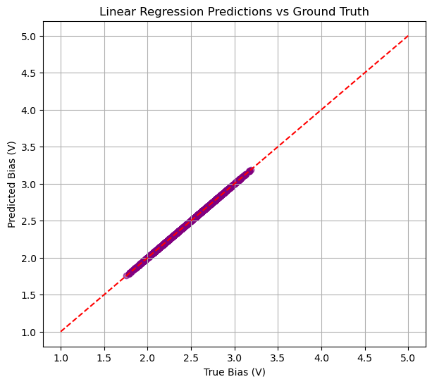
Results & Discussions
Machine Learning Output :
📊 Random Forest
Mean Absolute Error (MAE): 0.0037
Root Mean Square Error (RMSE): 0.0049
R² Score: 0.9998
📊 Gradient Boosting
Mean Absolute Error (MAE): 0.0039
Root Mean Square Error (RMSE): 0.0049
R² Score: 0.9998
📊 Neural Network (MLP)
Mean Absolute Error (MAE): 0.0904
Root Mean Square Error (RMSE): 0.1128
R² Score: 0.8750

Slide 18
Conclusion
Feasibility proven: optimal DC bias is predictable from runtime features without live sweeps.
Best deployment choice: Gradient Boosting balances accuracy, stability, and auditability; pair with clamps + override. But when paired with MLP will be useful in production.
Impact: moves LiFi toward self-optimising infrastructure with explicit accountability.
Result: gradient boosting attains sub-0.1 V MAE with strong R² and when paired with MLP it is suitable for production.

Slide 19

Limitation & Future work
Future Work
Multi-User Extensions
Extend methodology to multi-user LiFi cells, integrating optimal DC bias prediction with interference
Management.
Joint Parameter Optimisation
Explore joint optimisation of clipping thresholds, modulation order, and FEC rates alongside DC bias.
Regulatory Compliance
Conduct comprehensive testing for flicker and eye safety, incorporating learned bias control.

Slide 20

Thanks

